Slide 1
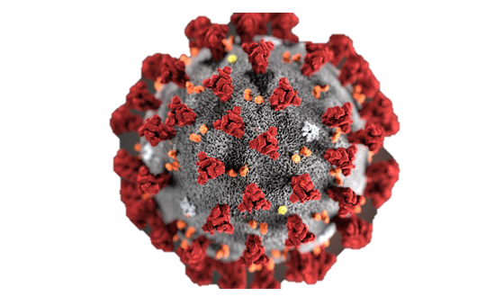
Detailed analysis on COVID-19 Data Trends
By AARTHI

Slide 2
Total COVID-19 Cases by Continent (2020-2022)
Across the analyzed years, Asia consistently reported the highest number of COVID-19 cases, followed by Europe and North America.

Slide 3
Global COVID-19 Mortality Rate Across Continents
COVID-19 mortality rates have steadily decreased globally from 3.1066% in 2020 to 1.2244% in 2022.
COVID-19 mortality rates vary across continents, ranging from 0.1928% in Oceania to 2.6483% in South America

Slide 4
Top 10 Countries with High Patient Numbers
United States leads with 40.9M hospitalizations, followed by France and Italy.

Slide 5
Total COVID-19 Tests Conducted Across continents and countries

Slide 6
A staggering 3.7 trillion global vaccinations underscore our united battle against COVID-19. Asia leads with 2.6 trillion jabs, showcasing immense vaccination drive. Europe, North America, and South America follow, highlighting collective efforts for a healthier future. Africa and Oceania, while on a smaller scale, contribute significantly.

Slide 7
Vaccination Coverage Across Regions
Vaccination rates vary widely across continents. North and South America lead with nearly 30% at least partially vaccinated, while Africa lags at 1.67%. Boosters are prominent in Europe and South America.

Slide 8
Average age of individuals who contracted COVID-19
Europe reports the highest average age at 34, indicating older populations are more affected. In contrast, Oceania, with an average age of 19, shows a younger impact.

Slide 9
Total cases reported based on the population density across countries

Slide 10
distribution of total cases and total deaths across different continents
Europe reports the highest total cases and deaths, underscoring the region's severe impact. Asia follows closely, while Oceania has the lowest numbers.

Slide 11
COVID-19 Impact on Life Expectancy
Life expectancy remained relatively stable from 2020 to 2022. While minor fluctuations occurred, the overall trend suggests a resilient average life expectancy, indicating a robust healthcare system and societal adaptability during challenging times.

Slide 12
Thank you

